Slide 1
Angular - Routing
Peter Eijgermans peter.eijgermans@ordina.nl

Slide 2
Routing architecture and goal
index.html
Home
Producten
/producten
/
/about
Contact
/contact
Over Ons

Slide 3
Routing – every route is a Component
HomeComponent (or: RootComponent, whatever) with main menu
Components are injected in <router-outlet></router-outlet>
HomeComponent
<router-outlet></router-outlet>
About
Product Component
Edit Component
… Component
Component

Slide 4

main.ts / bootstrapper
Services, components, etc
Router Module
ngModule / root module
MainComponent
main.routes.ts
AppComponent
Other components
Other components

Slide 5
Stappenplan routing
Base Href toevoegen in header van index.html (!)
<base href="/">
Er kunnen meerdere routes per module zijn. Elke component kan zijn eigen ChildRoutes definiëren.

Slide 6
2. Routes toevoegen. Convention: app.routes.ts.
// app.routes.ts
import {Routes} from '@angular/router'; import import {AppComponent} from "./app.component";
import {CityAddComponent} from "./city.add.component";
export const AppRoutes: Routes = [
{path: '', component: AppComponent},
{path: 'home', component: AppComponent},
{path: 'add', component: CityAddComponent}
];

Slide 7
3. Routes beschikbaar maken in Module
Import RouterModule in applicatie
Import ./app.routes in applicatie
…
// Router
import {RouterModule} from '@angular/router'; import {AppRoutes} from './app.routes';
Import Router- onderdelen
Nieuw!
MainComponent gaan we nog maken
// Components
import {MainComponent}
…
@NgModule({ imports : [
from './MainComponent';
BrowserModule, HttpModule, RouterModule.forRoot(AppRoutes)
Configure RouterModule.forRoot()
],
declarations: [ MainComponent, AppComponent, CityAddComponent
],
bootstrap : [MainComponent]
})
export class AppModule {
MainComponent wordt nu gebootstrapt
}

Slide 8
4. MainComponent met Routing maken
Nieuwe component met hoofdmenu en <router-outlet>
import {Component, OnInit} from '@angular/core';
“Hoofdmenu”. Let op routerLink
<!‐‐ Add routerLink directive. Angular replaces this with correct <a href="..."> ‐‐
<a routerLink="/home" class="btn btn‐primary">List of cities</a>
<a routerLink="/add" class="btn btn‐primary">Add City</a>
<hr>
<!‐‐ Dynamically inject views here ‐‐>
<router‐outlet></router‐outlet>
<!‐‐ Static footer here. Always visible‐‐>
`
@Component({
selector: 'main‐component', template: `
<h1>Pick your favorite city</h1>
<!‐‐ Static 'main menu'. Always visible‐‐>
<router-outlet>
})
export class MainComponent implements OnInit {
}
Lege Component

Slide 9
5. Eventueel: index.html aanpassen
Eventueel selector in index.html aanpassen
Als MainComponent een andere selector heeft
<div class="container">
<main‐component> Loading...
</main‐component>
</div>

Slide 10
6. Nieuwe component(en) maken en importeren
Elke component is een route
// city.add.component.ts
import { Component } from '@angular/core';
add‐city',
<h1>Add City</h1> …`
ityAddComponent{
@Component({ selector: ' template: `
})
// city.edit.component.ts
import { Component } from '@angular/core';
// city.detail.component.ts
ity',
it City</h1> …`
tComponent{
@Component({ selector: 'edit‐c template: `<h1>Ed
})
import { Component } from '@angular/core'
export class C
…
}
@Component({
selector: 'detail‐city', template: `<h1>Detail City</h1> …`
})
export class CityEdi
…
}
export class CityDetailComponent{
…
}

Slide 11
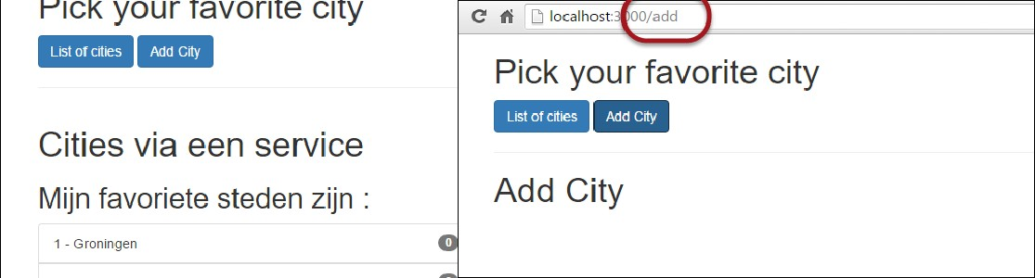

8. Testen

Slide 12
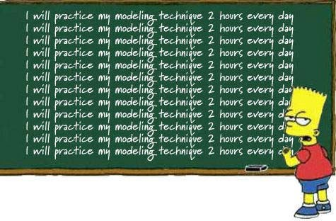
Checkpoint
Routes worden op component-niveau ingesteld
Volg het stappenplan. Denk aan injecteren van RouterModule,
app.routes.ts en <base href=“/”> in de HTML
Oefening 7a + 7b
Oefening….

Slide 13
Routeparameters
Master-Detail views en –applications

Slide 14
Dynamische routes maken
Doel: Enkele detailpagina voor klanten, producten, diensten, etc.
Leesbare routes als: /cities/5, of products/philips/broodrooster, enzovoort
Werkwijze:
Aanpassen app.routes.ts en hyperlinks in de pagina.
Import ActivatedRoute in de detail component
Detail component toevoegen aan Module (app.module.ts)
Schrijf hyperlinks als <a [routerLink]=…> met parameter

Slide 15
1. app.routes.ts aanpassen
// app.routes.ts
import {Routes} from '@angular/router'; import import {AppComponent} from "./app.component";
import {CityAddComponent} from "./city.add.component"; import{CityDetailComponent} from "./city.detail.component";
export const AppRoutes: Routes = [
{path: '', component: AppComponent},
{path: 'home', component: AppComponent},
{path: 'add', component: CityAddComponent},
{path: 'detail/:id', component: CityDetailComponent}
];

Slide 16
2. Detail Component maken
// city.detail.component.ts
…
// import {RouteParams} from | "@angular/router"; // OLD | way
import {ActivatedRoute} from | '@angular/router';
@Component({
selector: 'city‐detail', template: `<h1>City Detail</h1>
<h2>Details voor city: {{ id }}</h2>
`
})
ActivatedRoute
export class CityDetailComponent implements OnInit, OnDestroy { id: string;
currentCity: City;
constructor(private route: ActivatedRoute) {} ngOnInit() {
this.route.params
.subscribe((id: any) => {
this.id = id;
});
}
}
Notes:
ActivatedRoute comes with a 'params' property which is an Observable.
To access the property 'id', all we have to do is to subscribe to
The parameters Observable changes

Slide 17
2a. DetailComponent - variants
// Work via Router‐snapshot:
// Sometimes we’re not interested in future changes of a route parameter.
// All we need the id and once we have it, we can provide the data we want to provide.
// In this case, an Observable can bit a bit of an overkill.
// A *snapshot* is simply a snapshot representation of the activated route.
this.id = this.route.snapshot.params['id'];
this.name = this.route.snapshot.params['name'];
Using router snapshots

Slide 18
2b. DetailComponent - variants
ngOnInit() {
// NEW:
this.sub = this.route.params
.subscribe((params: any) => { this.id = params['id']; this.name = params['name'];
});
}
.unsubscribe()
ngOnDestroy() {
// If subscribed, we must unsubscribe before Angular destroys the component.
// Failure to do so could create a memory leak.
this.sub.unsubscribe();
}

Slide 19
3. Detail component toevoegen aan Module
// app.module.ts
…
// Components
import {CityDetailComponent} @NgModule({ | from './city.detail.component';
imports
…
],
: [
declarations: [
… CityDetailComponent
],
Component
providers bootstrap
: [CityService],
: [MainComponent]
})
export class AppModule {
}

Slide 20
4. App Component (‘Master View’) aanpassen
<li *ngFor="let city of cities" class="list‐group‐item">
<a [routerLink]="['/detail', city.id]">
{{ city.id}} ‐ {{ city.name }}
</a>
</li>
Let er op dat [routerLink] nu dynamisch moet worden gevuld en dus binnen […] moet staan voor attribute binding

Slide 21
Checkpoint
RouteParameters worden met :parameterName ingesteld in
app.routes.ts.
Denk aan injection van ActivatedRoute in de component.
Hierin is een property .params aanwezig met de meegegeven parameters.
Oefening 7c
Oefening….

Slide 22
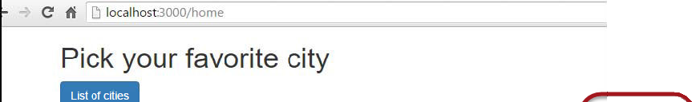
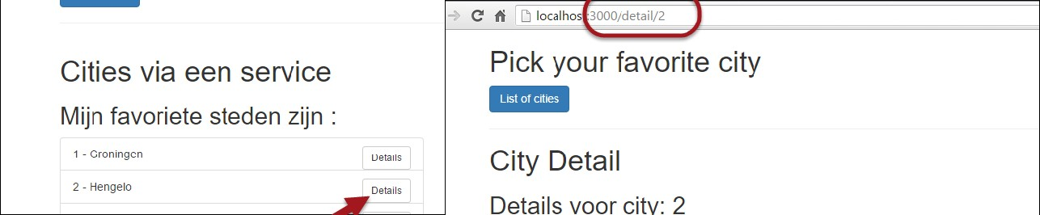
ADVANCED: Meegeven van parameters
Let op meegeven van array van parameters aan [routerLink]
Parameters worden gematched op positie. Niet op naam.
Optioneel : service uitbreiden om specifiek product/item te retourneren

Slide 23
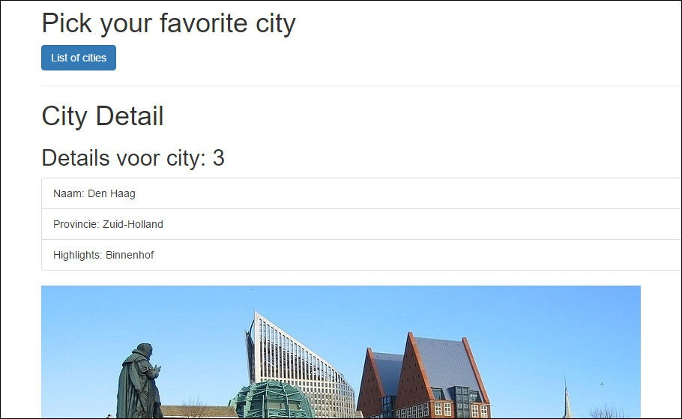
Vervolg – details via Service
Uncomment de regels die te maken hebben met cityService:
// NEW, with fetching details via Service:
this.sub = this.route.params
.map(params => params['id'])
.switchMap(id => this.cityService.getCity(id))
.subscribe((city) => { this.currentCity = <City>city[0];
});
23

Slide 24
In city.service.ts:
Bijvoorbeeld (kan beter, maar het werkt wel):
// retourneer een city, op basis van ID
getCity(id: string): City[] {
return this._http.get('app/cities.json')
.map(cities =>cities.json())
.map(cities => cities.filter((city: City) => {
return city.id === parseInt(id);
}))
}

Slide 25
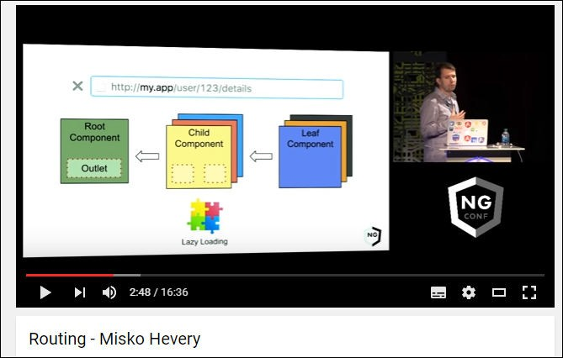
New Component Router
https://www.youtube.com/watch?v=d8yAdeshpcw

Slide 26
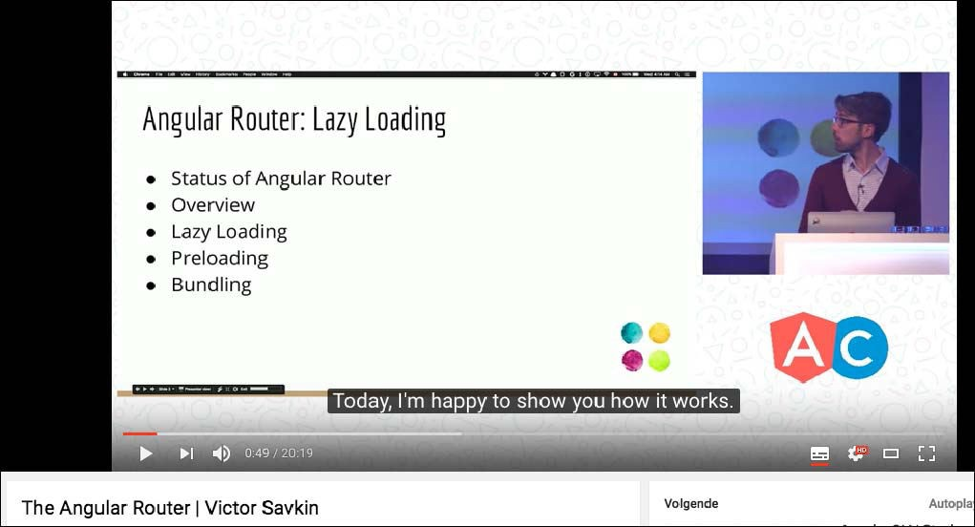
https://www.youtube.com/watch?v=QLns6s02O48

Slide 27
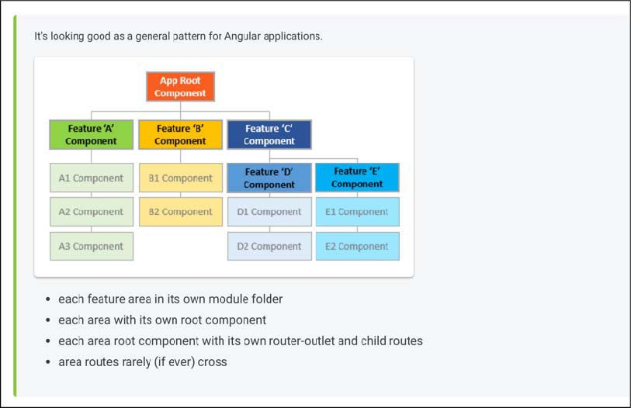
Advanced routing
https://angular.io/docs/ts/latest/guide/router.html

Slide 28
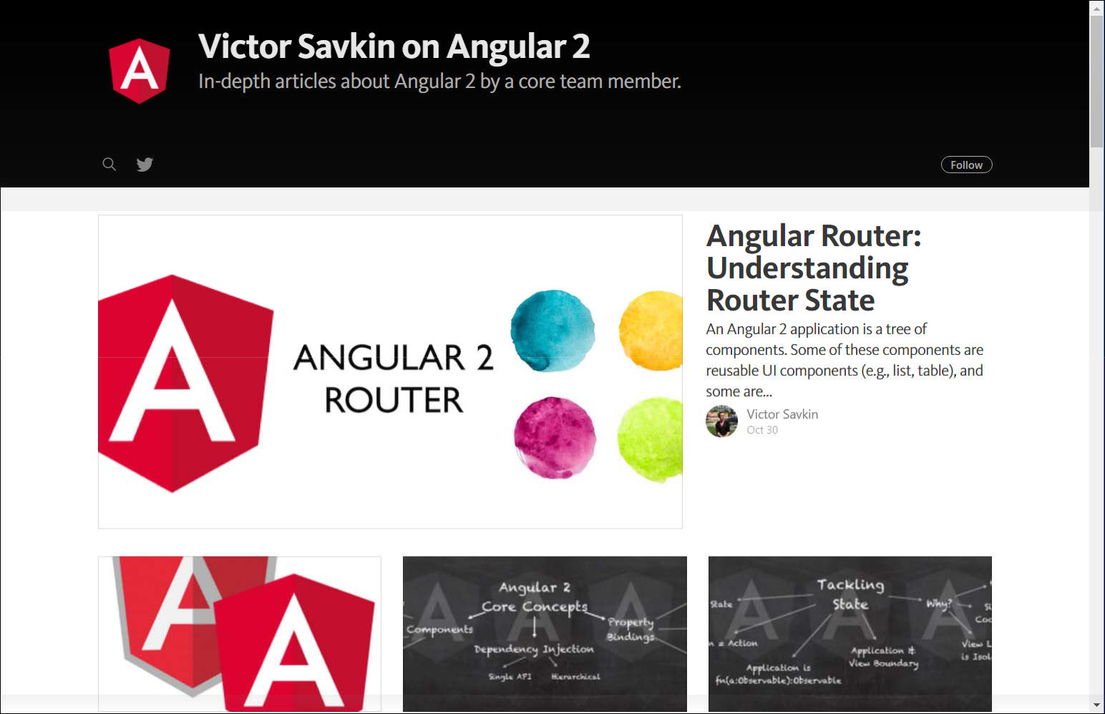
Victor Savkin on Routing
Victor Savkin – creator of the router
https://vsavkin.com/

Slide 29
Pipes
Pipes zijn filters

Slide 30
Syntax pipes
city.name | uppercase
city | json | lowercase -> pipe chaining
Obervable$ | async
SYNTAX:
expressive | pipeNaam [ parm1 [parmN]]
startdate | date: ‘MMddyyyyHHmm’

Slide 31
Custom pipes
import {Pipe, PipeTransform} from '@angular/core';
@Pipe({
name: 'filter’
})
export class FilterPipe implements PipeTransform {
transform(value: any[], args: any[]) {
return;
}
}

Slide 32
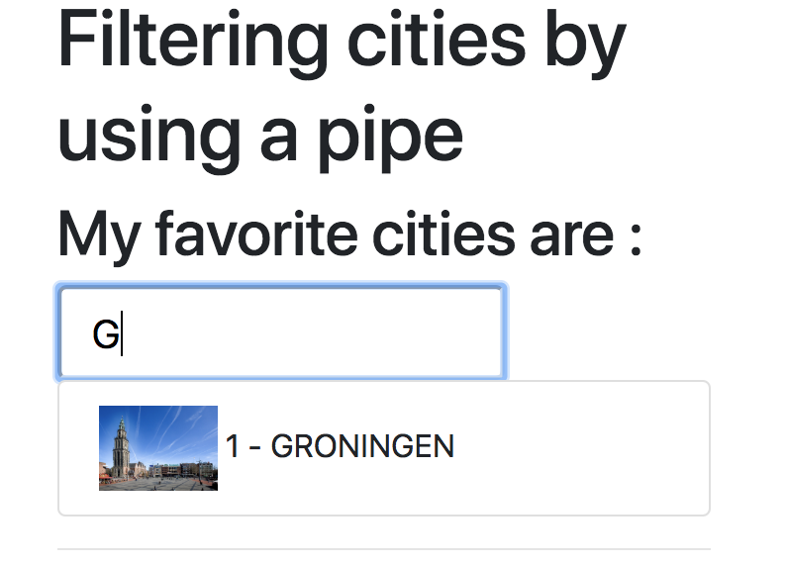

Slide 33
Custom pipes
import {Pipe, PipeTransform} from '@angular/core';
@Pipe({
name: 'filter'
})
export class FilterPipe implements PipeTransform {
transform(value: any[], args: any[]) {
if (!args) {
return value;
}
if (value) {
const searchFilter = args[0].toLowerCase();
return value.filter((item) => item.name.toLowerCase().startsWith(searchFilter));
}
return;
}
}

Slide 34
Checkpoint pipes
Oefening 8a
Oefening….

